Slide 1


Slide 2
Personality can be defined as a dynamic and organized set of characteristics possessed by a person that uniquely influences his or her cognition, motivations, and behaviors in various situations. The word "personality" originates from the Latin persona, which means mask.

Slide 3

Heredity
Environment

Slide 4
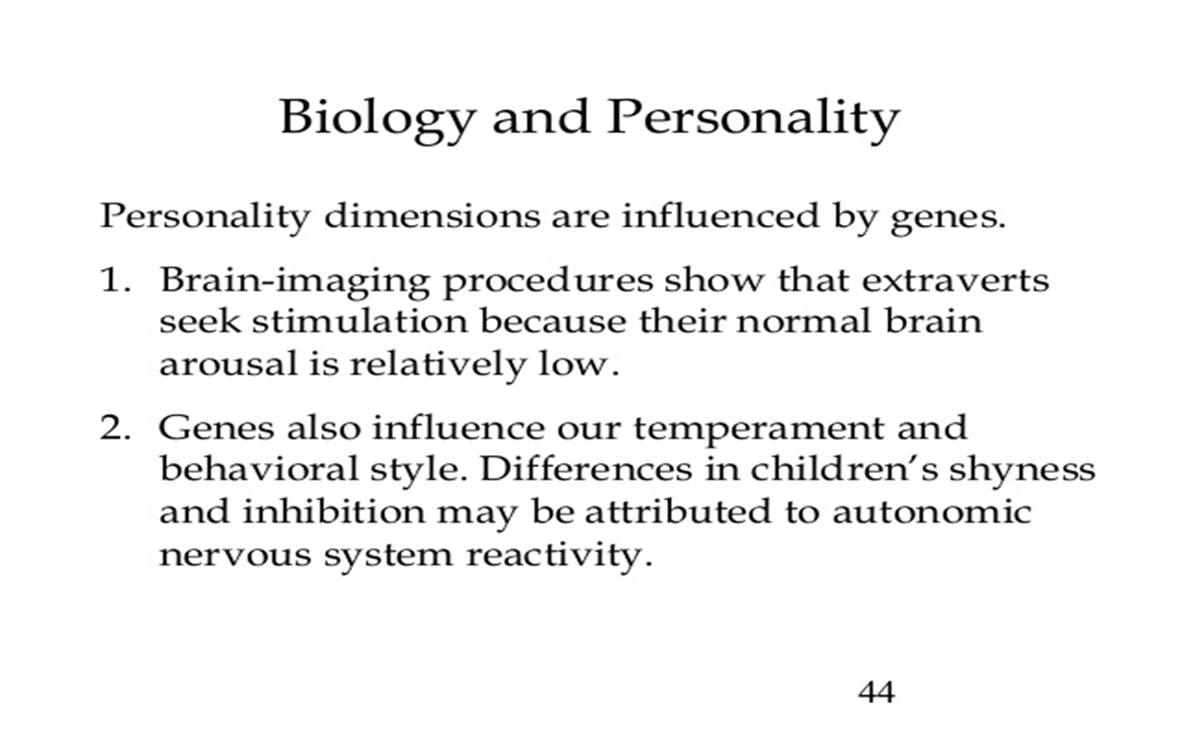

Slide 5
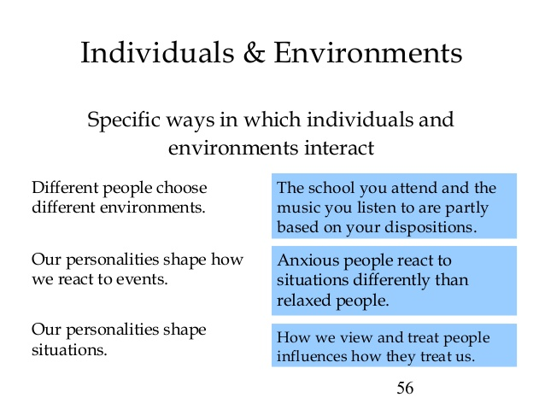

Slide 6

Hippocrates
Trait Theory by Gordon Allport
Five Factor Model by Lewis Goldberg
Psychodynamic personality theory

Slide 7

The Four Humors - Ancient Greeks (~2000 BC - 0 AD)
Ancient Greek philosophers such as Hippocrates 400 BC and Galen, 140/150 AD classified 4 types of "humors" in people. Each type was believed to be due to an excess of one of four bodily fluids, corresponding to their character. The personalities were termed "humors".
Sanguine(blood;happy passionate)
Melancholic(black bile;gloomy pessimistic)
Phelgmatic(Phlegum;dull,sluggish)
Choleric(yellow bile;hot tempered)

Slide 8
Character | Humor | Fluid | Corresponding Trait in the Big 5
Irritable | Choleric | yellow bile | Agreeableness
Depressed | Melancholic | black bile | Neuroticism
Optimistic | Sanguine | blood | Openness to experience
Calm | Phlegmatic | phlegm | Neuroticism

Slide 9

Hans Eysenck, who believed just three traits - extraversion, neuroticism and psychoticism - were sufficient to describe human personality.

Slide 10

Allport is known as a "trait" psychologist. He developed a list of 4500 trait like words. He organized these into three levels of traits.
1. Cardinal trait - This is the trait that dominates and shapes a person's behavior. These are rare as most people lack a single theme that shapes their lives.
2. Central trait - This is a general characteristic found in some degree in every person. These are the basic building blocks that shape most of our behavior although they are not as overwhelming as cardinal traits. An example of a central trait would be honesty.
3. Secondary trait - These are characteristics seen only in certain circumstances (such as particular likes or dislikes that a very close friend may know). They must be included to provide a complete picture of human complexity.

Slide 11

Lewis Goldberg proposed a five-dimension personality model, nicknamed the "Big Five":
  Extraversion - outgoing and stimulation-oriented vs. quiet and stimulation-avoiding
  Neuroticism - emotionally reactive, prone to negative emotions vs. calm, imperturbable, optimistic
  Agreeableness - affable, friendly, vs. aggressive, dominant, disagreeable
  Conscientiousness - dutiful, planner, and orderly vs. laidback, spontaneous, and unreliable
  Openness to experience - open to new ideas and change vs. traditional and oriented toward routine

Slide 12
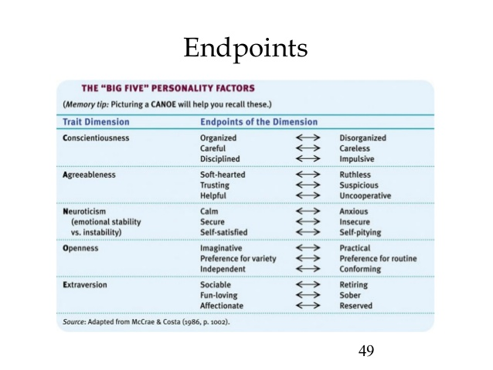

Slide 13
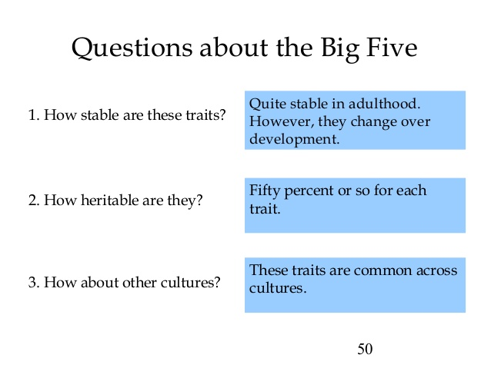

Slide 14

The Type A and Type B personality theory is a personality type theory that describes a pattern of behaviors that were once considered to be a risk factor for coronary heart disease.
There is also a Type AB mixed profile for people who cannot be clearly categorized.

Slide 15

Type A individuals can be described as impatient, excessively time-conscious, insecure about their status, highly competitive, hostile and aggressive, and incapable of relaxation. They are often high achieving workaholics who multi-task, drive themselves with deadlines, and are unhappy about the smallest of delays. Because of these characteristics, Type A individuals are often described as "stress junkies."

Slide 16

Type B individuals, in contrast, are described as patient, relaxed, and easy-going.
Symptoms of Type A Behavior
An intrinsic insecurity or insufficient level of self-esteem, which is considered to be the root cause of the syndrome. This is believed to be covert and therefore less observable.
Time urgency and impatience, which causes irritation and exasperation.
Free floating hostility, which can be triggered by even minor incidents.

Slide 17


Collectivism is defined as the theory and practice that makes some sort of group rather than the individual the fundamental unit of political, social, and economic concern. In theory, collectivists insist that the claims of groups, associations, or the state must normally supersede the claims of individuals.

Slide 18
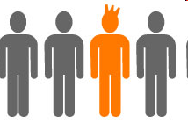
"Individualism is at once an ethical-psychological concept and an ethical-political one. As an ethical-psychological concept, individualism holds that a human being should think and judge independently, respecting nothing more than the sovereignty of his or her mind; thus, it is intimately connected with the concept of autonomy. As an ethical-political concept, individualism upholds the supremacy of individual rights

Slide 19
Psychoanalytic Perspective Of Personality
SIGMUND FREUD

Slide 20

Unconscious:
The unconscious is understood to be the large part of the mind, which is hidden from view.
Pre-conscious:
The pre-conscious is represented by the waterline - but it is the zone in which there are fleeting glimpses of the unconscious, "flickering" across the screen of consciousness.
Conscious:
The relatively small part which sticks to the surface of water is seen as equivalent to the small amount of conscious awareness that the human experiences.

Slide 21
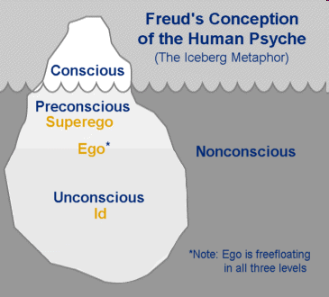

Slide 22

Elements Of Personality (Freud’s View):
The Id
The Ego
The Superego

Slide 23

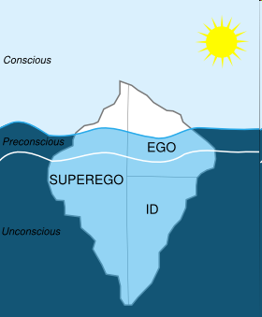

Slide 24

Primary component of personality
Pleasure principle
Strives for immediate satisfaction of all desires, needs, wants
For example, if an infant feels hungry, he will cry till his want is satisfied.
ID fails result in tension, anxiety

Slide 25

Responsible for dealing with reality.
Reality principle weighs the cost of doing or abandoning something
Discharges tension by finding the object in the real world created by Id.
It resolves conflicts between id impulses and constraints of super ego by developing ego defense mechanism to distort reality

Slide 26

Holds of our internalized moral standards that we acquire from parents, society.
Has two parts:-
The ego Ideal
Good Behaviors
The Conscience
Bad Behaviors

Slide 27
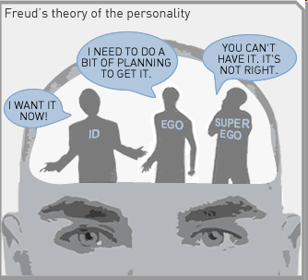

Slide 28

A defense mechanism is a tactic developed by the ego to protect against anxiety. Defense mechanisms are thought to safeguard the mind against feelings and thoughts that are too difficult for the conscious mind to cope with.

Slide 29
Repression
The removal of threatening thoughts from awareness; or conscious to unconscious
Projection
The attribution of unacceptable impulses to others;
Denial
The refusal to recognize a threatening situation or thought;
Rationalization
Giving a reasonable explanation for an event;
Regression
The return to a less mature, anxiety reducing behavior;
Reaction formation
The expression of the opposite of disturbing ideas;
Displacement
Substituting a less threatening object for impulses;
Sublimation
The channeling of impulses to socially acceptable outlets.

Slide 30
6 Personality
Case Study
A group of girls get into a verbal argument after one of the girls is accused of ruining an art project which did not belong to her. Two of the girls start to yell obscenities at the girl who allegedly ruined the project. This girl retaliates by threatening violence. The two other girls follow suit. Eventually, the argument escalates further to more yelling and threats. When questioned later individually, it is learned that one of the girls had a rough phone call with her mother and found out her father would not be visiting her. Another of the girls had a similar experience, as her parents visited during the week and she did not "get along" with them. Finally, the girl accused of ruining the project was just admitted and angry at her parents for placing her in treatment. One of the behavioral techs redirected the girls to playing sports and painting. The girls seem to calm down and de-escalate.
Question: What defense mechanism (s) is the three girls utilizing and why? Explain. Are there any other defense mechanisms at work here?

Slide 31
Rubrics
All three of the girls are using repression and displacement as defense mechanisms. The first girl is upset and probably hurt because her father is not coming to see her so, she takes her anger and pain out on another girl. She has been hiding her hurt and anger but is now releasing it in the form of being aggressive towards another girl. The second girl is upset because her parents did come to visit her but things did not go well because she does not get along with her parents. She too has been holding in her anger and pain now to release it on someone else. The third girl is angry because her parents placed her in treatment and she is displacing that anger on someone’s project. While the first two girls are displacing their anger on another human, the third girl displaced her anger unto an object; nonetheless, they are all displacing their emotions they have towards their parents while maintaining positive relations with their parents. A possible third defense mechanism is occurring, introjection. The girl who is being accused threatens violence and the other two girls follow suit by threatening violence as well to keep them from feeling inferior.

Slide 32

Freud advanced a theory of personality development that centered on the effects of the sexual pleasure drive on the individual psyche. At particular points in the developmental process, he claimed, a single body part is particularly sensitive to sexual, erotic stimulation. These erogenous zones are the mouth, the anus, and the genital region.

Slide 33
The Oedipus complex, in psychoanalytic theory, is a group of largely unconscious (dynamically repressed) ideas and feelings which centre around the desire to possess the parent of the opposite sex and eliminate the parent of the same sex. According to classical theory, the complex appears during the so-called 'oedipal phase' of libidinal and ego development; i.e. between the ages of three and five, though oedipal manifestations may be detected earlier.

Slide 34
Freudian psychosexual stages
In Freudian psychology, each child passes through five psychosexual stages. During each stage, the id focuses on a distinct erogenous zone on the body.

Slide 35
Age | Name | Pleasure source | Conflict
0-2 | Oral | Mouth: sucking, biting, swallowing | Feeding, nail biting
2-4 | Anal | Anus: defecating or retaining feces | Toilet training
4-5 | Phallic | Genitals | Oedipus (boys), Electra (girls)
6- puberty | Latency | Sexual urges sublimated into sports and hobbies. Same-sex friends also help avoid sexual feelings.
Puberty onwards | Genital | Physical sexual changes reawaken repressed needs. Direct sexual feelings towards others lead to sexual gratification. | Social rules

Slide 36
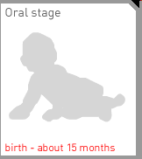
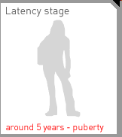
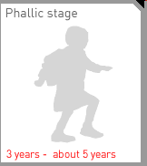
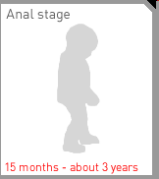
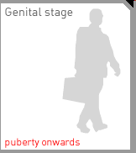

Slide 37

The Neo-Freudian psychologists were those followers of Sigmund Freud who accepted the basic tenets of his theory of psychoanalysis but altered it in some way.

Slide 38

While Horney acknowledged and agreed with Freud on many issues, she was also critical of him on several key beliefs. She is also known as neo-Freudian.

Slide 39
Basic Anxiety is a term used by the psychologist Karen Horney to explain the ramifications of poor parenting. Basic anxiety is deep insecurity and fear that have developed in the child because of the way they were treated by their parents. It is developed because of the conflict with dependency and hostility towards mom, dad, or both. Horney argued that a child is tied to his or her parent because of dependence, not sex (as Sigmund Freud would argue). The child is dependent on the mother and father for food, shelter, and the basic needs. However, the child realizes that no matter how terrible mother and father treat him or her, he or she has nowhere to go because they are so dependent on the parents.

Slide 40
Horney suggests that there are three basic strategies people use to cope with basic anxiety: by moving toward people and adopting a self-compliant solution; moving against people and adopting an aggressive solution; and moving away from people and becoming detached and resigned.

Slide 41
Early childhood is important in the shaping of behaviour because of basic anxiety, which to Horney is our main motivator, resulting from feelings of isolation and helplessness. New-born children need security as they are unable to care for themselves, and the early relationship between baby and caregiver causes people to develop particular personality tendencies as evidenced by their ways of relating to others:
Moving towards people (sociability; compliance) -- the need for affection, approval, and a partner. The person wants to be liked and please others.
Moving away from others (isolation; detachment) -- the need for self-sufficiency and independence, and sometimes perfection. Extreme needs for isolation might result in a near-total withdrawal from others.
Moving against others (mistrust; aggression) -- the need for social recognition, power, personal admiration, personal achievement, and to exploit others.

Slide 42

Carl Gustav Jung was a Swiss psychiatrist, an influential thinker and the founder of Analytical psychology.

Slide 43
He gave the following ideas:
The concept of introversion (Introverts often enjoy solitary activities like reading) and extraversion (Extraverts typically thrive in groups).
The concept of Collective Unconscious, which is shared by all people and it is the collective memory of human experience. It includes the archetypes. In psychology, an archetype is a model of a person, personality, or behavior, which is inherited primitive images or impression by that human race.

Slide 44
Archetypes:
Mother archetype:
The mother archetype is a particularly good example. All
of our ancestors had mothers.
The persona:
The persona represents your public image.
*Anima and animus:
The anima is the female aspect present in the collective unconscious of men, and the animus is the male aspect present in the collective unconscious of women.

Slide 45

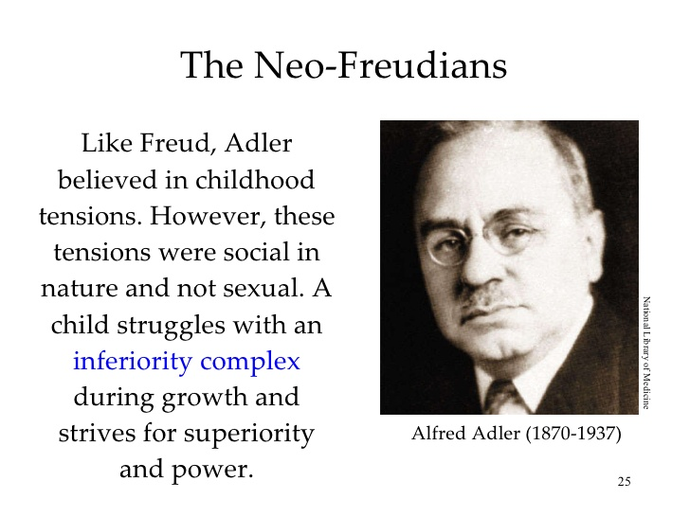

Slide 46
STRIVING FOR SUPERIORITY (OR PERFECTION)
The basic dynamic force between all human activity -- striving from a feeling of inferiority to one of superiority.
"To be a human being," he wrote, "means to feel oneself inferior." Adler believed that inferiority feelings are the source of all human striving. All individual progress, growth and development result from the attempt to compensate for one's inferiorities.

Slide 47

Behavioral theories suggest that personality is a result of interaction between the individual and the environment. Behavioral theorists study observable and measurable behaviors, rejecting theories that take internal thoughts and feelings into account.

Slide 48

Skinner's theory is based on operant conditioning, which means when the organism is operating on the environments, the organism will encounter a special kind of reinforcing stimulus or simply a reinforcement.
Reinforcement increases a behavior and punishment decreases or ends it.

Slide 49

There are two main cognitive social learning theories, those of Bandura and Mischel. Bandura pioneered the study of observational learning .Cognitive theories stress on importance of behaviour,cognition and environment. Both stress on role of cognition with interaction of environment teaching self control in social learning.Bandura believed that, rather than operating in a mechanistic way, reinforcement provides information about future.

Slide 50

Humanistic psychologists try to see people’s lives as those people would see them. They tend to have an optimistic perspective on human nature

Slide 51
Carl Rogers humanistic psychologist, proposed a theory called the person-centered theory. In Rogers’s view, the self-concept is the most important feature of personality, and it includes all the thoughts, feelings, and beliefs people have about themselves. Rogers believed that people are aware of their self-concepts.

Slide 52
Main concepts of his theory:-
Positive regard:
Acceptance, unconditional positive regard towards the client.
Congruence:
Genuineness, honesty with the client.
Empathy:
The ability to feel what the client feels.
Self concept:
The organized set of characteristics that the individual perceives as peculiar to himself/herself“.

Slide 53

Personality is the measurement of personal characteristics
Personality is determined by traits
Clinical psychologists use assessments for diagnosing psychological disorders
Mental health providers use tests to counsel people about daily living
Organization use assessment to select personnel to hire
Researchers use test for studying personality traits
Two important ways of assessing personality are
Non projective tests
Projective tests

Slide 54

Objective personality test are self report inventories about person typical behavior
Three important ways of assessing include
MMPI-2
CPI
The 16PF

Slide 55
Minnesota Multiphasic Personality Inventory – 2
It contains 567 true, false or cannot say question
It was developed to diagnose psychological disorders
It is divided into fourteen scales
Score profile or patterns across subscales indicate psychological disorders

Slide 56
California Personality inventory
It is derived from MMPI-2
Contains 434 yes, no questions
Scores are yield on scales including self acceptance, self control, achievement

Slide 57
THE 16PF
It is the test that assess sixteen basic dimension of personality
Includes list of 187 questions

Slide 58

An objective test where we can use structured,unstructured,exhaustive questioning to asses ones personality.
In certain situations we can also use performance testing to test individual personality traits.

Slide 59

Advantages
Useful in getting precise answers to standard questions
Self report inventories contain transparent questions
Disadvantages
Social desirability bias can effect response on self report inventories
People don’t understand the questions
People sometimes don’t remember the experience they are asked about

Slide 60

In projective personality tests subjects are required to respond to different stimuli that are interpreted in many ways. Tests are based on projective hypothesis.
Rorschach Ink blot test
TAT
HTP
Word association test

Slide 61

The Rorschach Ink blot Test
It contains series of ten pictures
Subject describes what they look
It gives information about personality traits

Slide 62
Thematic Apperception Test
It contains series of pictures and scenes
Subject make a theme and illustrate the story of scenes

Slide 63
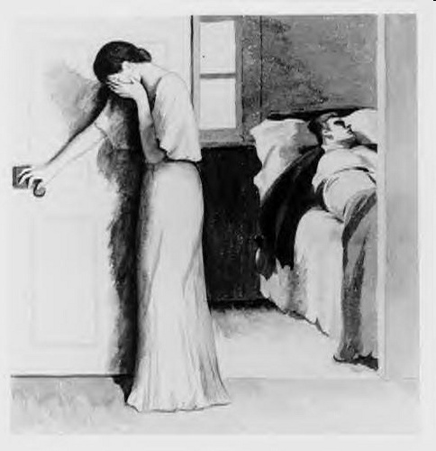

Slide 64
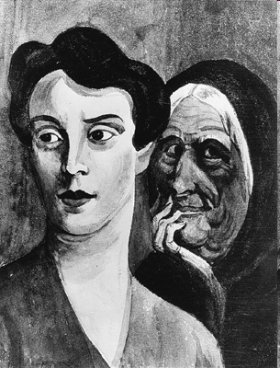

Slide 65

House Tree Test
Subject is asked to make picture of house, tree and person
house, tree and person describes different aspects of person psychology

Slide 66

Case scenario big five personality
Indicate the name of each personality type from big five personality with each scenario:
Alisha is highly disciplined and does her chores right away.
Ahmed is open to traveling to new places spontaneously. He likes to explore places around.
Emma loves to hang out and is the life of the parties. She is a fun loving and lively person. She is fun to be around.
Saad always finds time for others. He has a busy schedule but he takes time out for his friend to meet for lunch.
Jamal loses his temper easily and seems to be anxious over small matters as well.
Rubrics
Conscientious
Open to new experiences
Extraversion
Agreeableness
Neuroticism

Slide 67
Site for PERSONALITY TESTS:
http://www.humanmetrics.com/cgi-win/JTypes1.htm
Site for test interpretation of HTP:
http://www.orthopedagogiek.info/house_tree_person_drawings.htm

